Slide 1

CONTENTS
INTRODUCTION BLOCK DIAGRAM APP DEVELOPMENT WORKING PROS AND CONS FUTURE SCOPE CONCLUSION

Slide 2
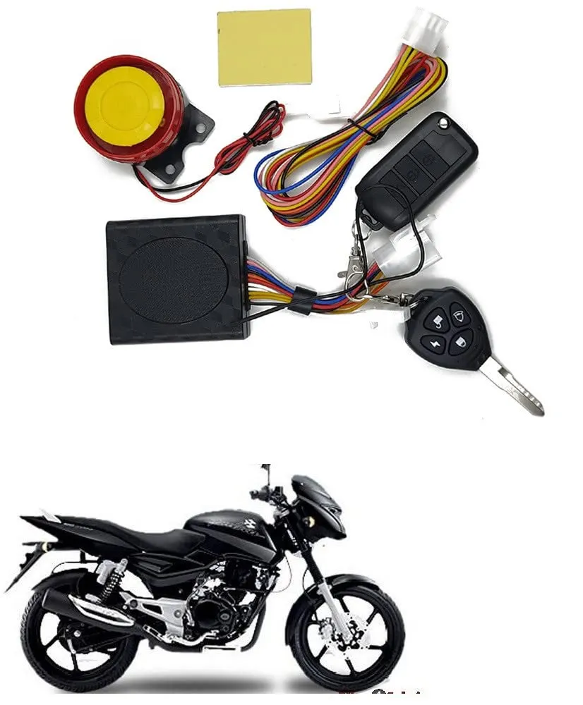
INTRODUCTION
This project examines the use of automobile vehicle keys that are connected to smartphones and can be accessed through RFID KEY and TAG. The technology used here is based on ARDUINO and some of them are equipped with BLUETOOTH MODULE HC-05 and RELAY.

Slide 3
ACCESS METHOD
CONVENTIONAL ENERGY SOURCE
NON-CONVENTIONAL ENERGY SOURCE
AN ALTERNATE ENERGY SOURCE

Slide 4
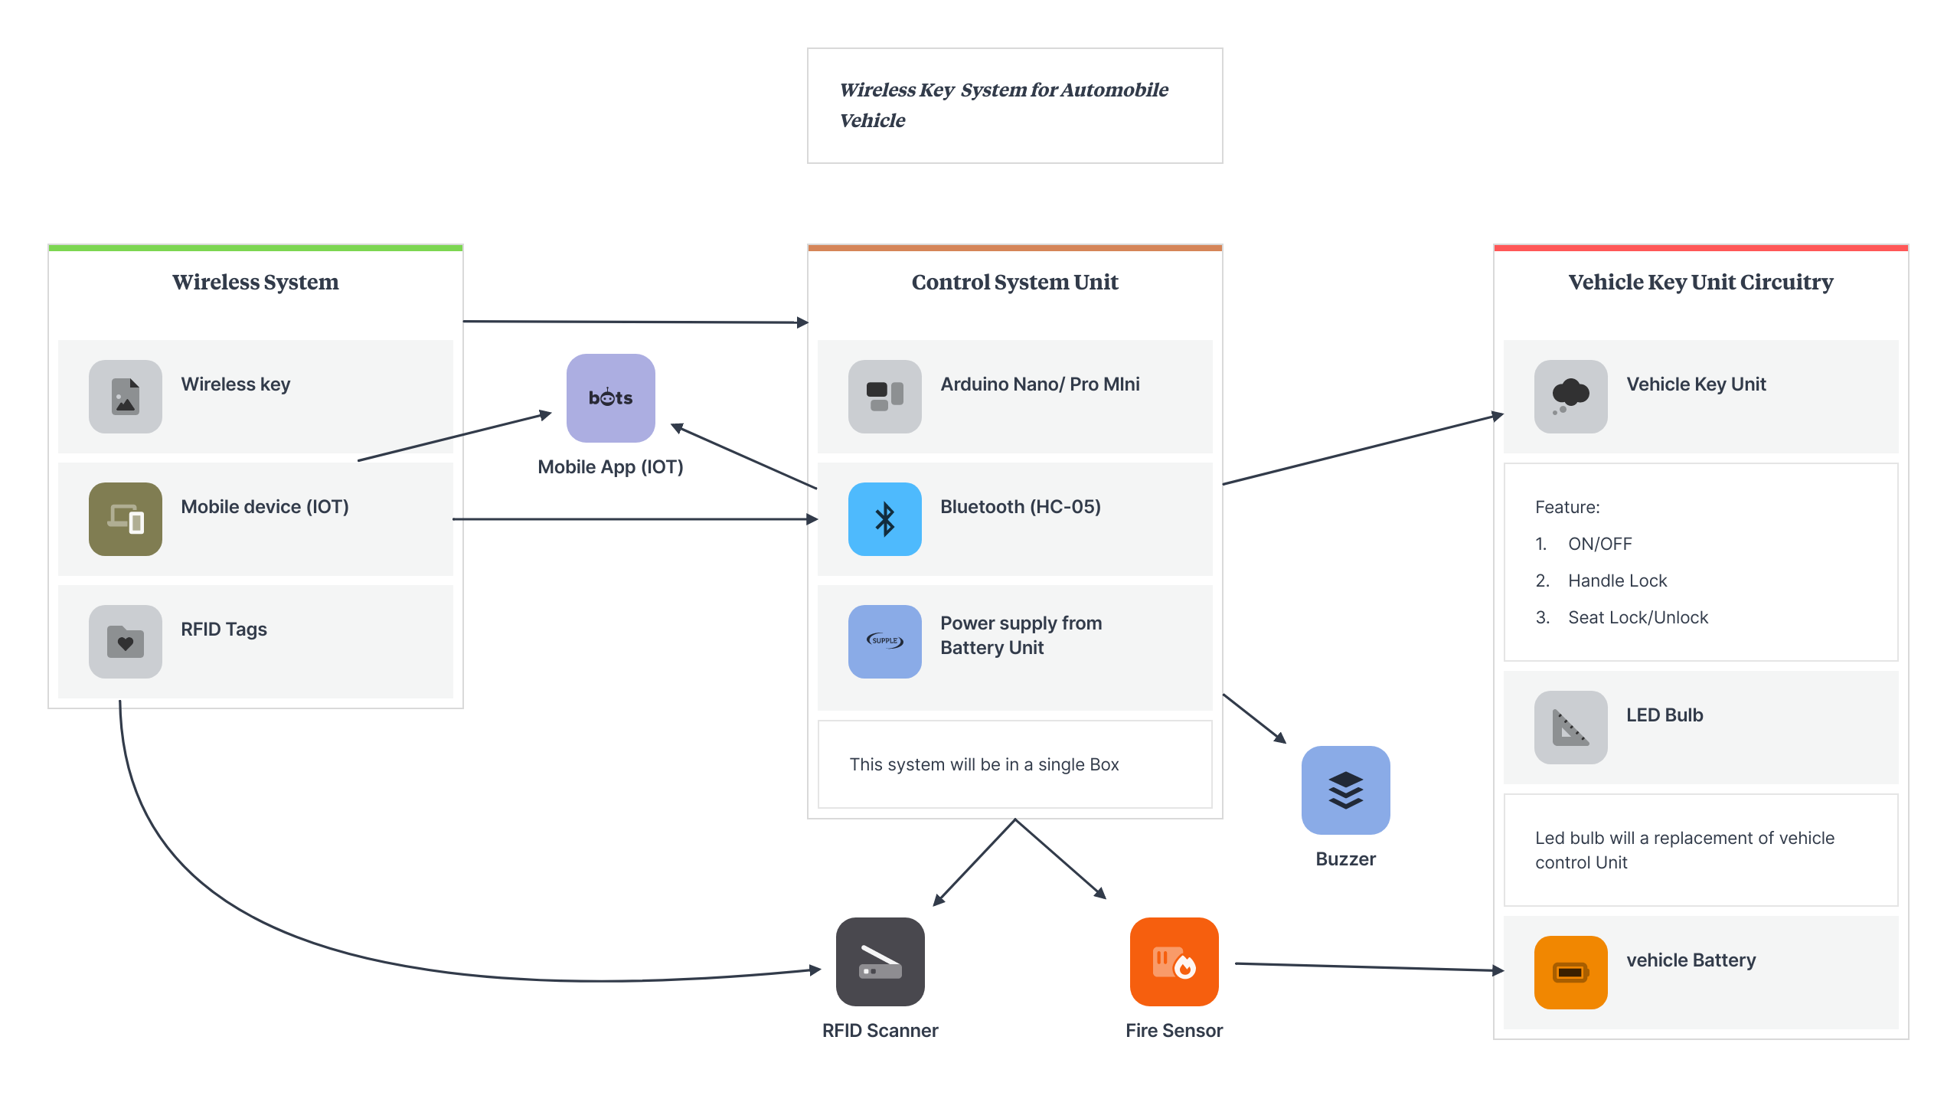
BLOCK DIAGRAM

Slide 5
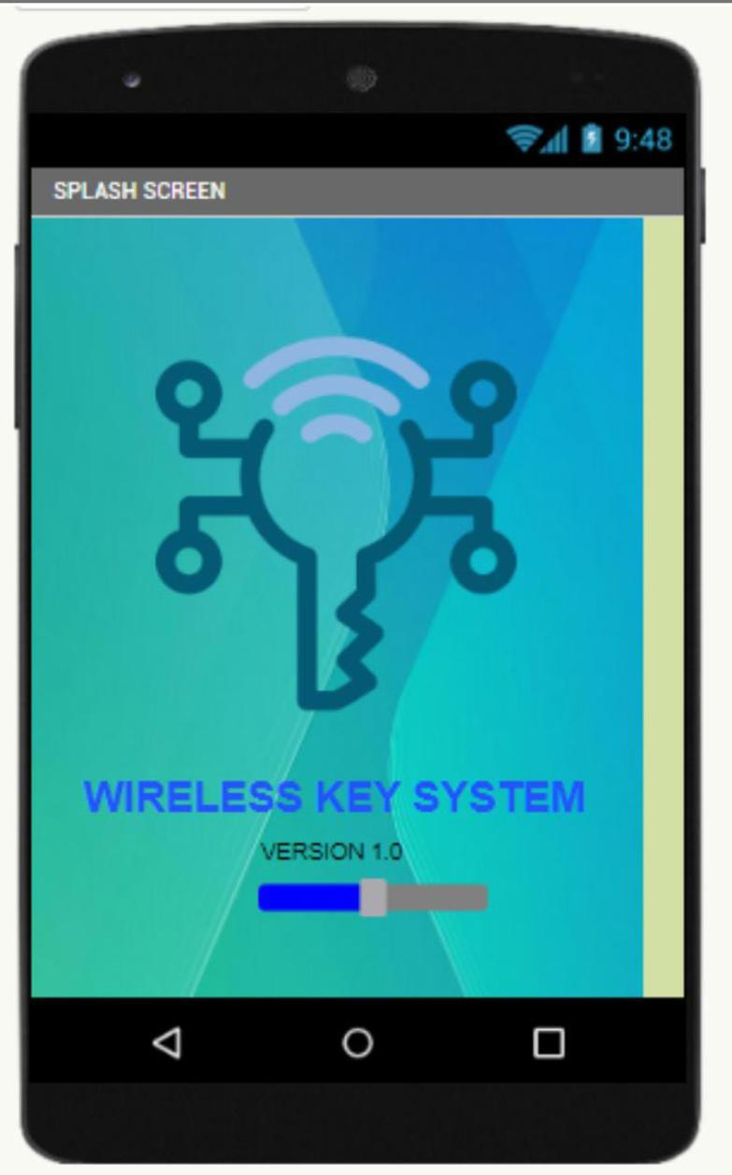
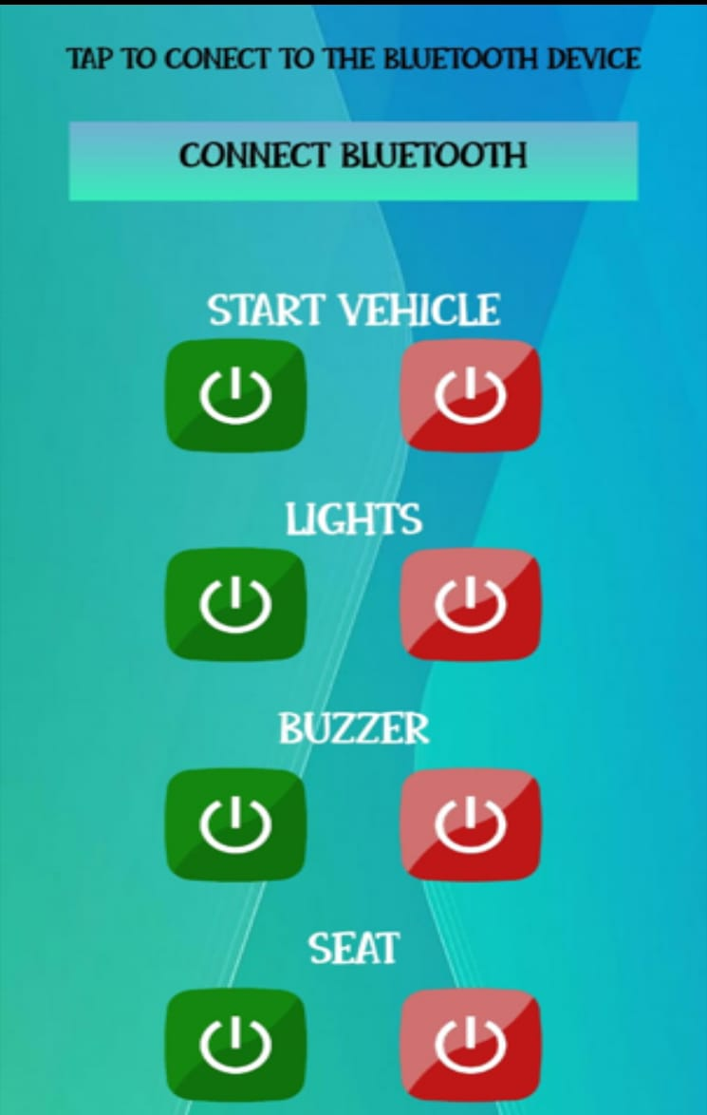
APP DEVELOPMENT
The app was developed using the mit app inventor. It is simple app consisting of two screens: Splash screen Bluetooth connection and controlling

Slide 6

PRO`S AND CON`S
PRO`S
CON`S
RELIABLE.
ECO-FRIENDLY.
ALTERNATE WAY OF POWER GENERATION.
INITIAL COST IS TOO HIGH.
IMPLEMENTATION IS DIFFICULT.
MORE MAINTENANCE.

Slide 7

FUTURE SCOPE
The concept of a smart key that is designed to enrich the usability of an electric bike, to inform the owner about the vehicle status, its current operating conditions and control important security functions can also be done

Slide 8
BIBLIOGRAPHY
https://aip.scitation.org/doi/abs/10.1063/1.5118105
https://www.ijraset.com/research-paper/footstep-power-generation-using-piezoelectric-sensor
https://www.smart-energy.com/industry-sectors/new-technology/energy-generated-from-footsteps-can-power-indias-green-revolution-study/

Slide 9

CONCLUSION
The approach provides a stable bidirectional communication with low latency to improve efficiency and portability.

Slide 10

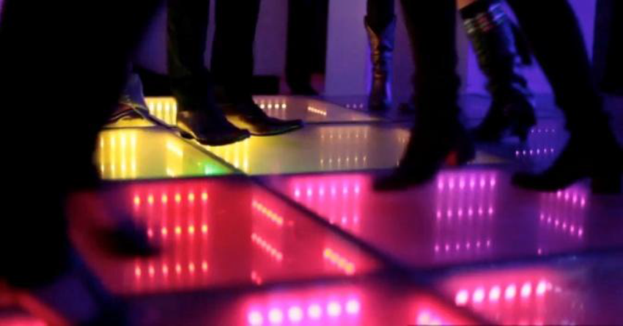
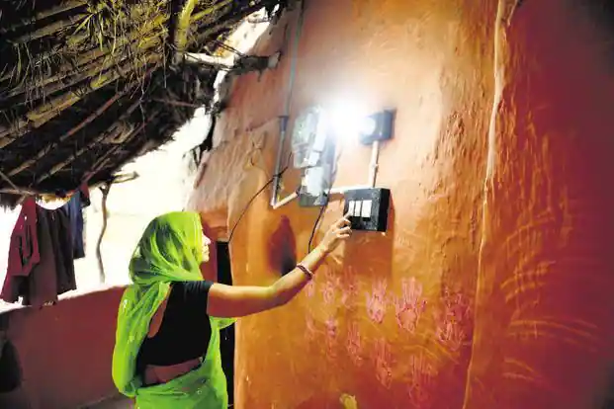
APPLICATION
RAILWAY STATION
DANCING FLOORS
RURAL AREAS

